Slide 1

Software Defined Networking
Chen Qian
Department of Computer Science and Engineering
qian@ucsc.edu
https://users.soe.ucsc.edu/~qian/

Slide 2



Networks are Hard to Manage
Operating a network is expensive
  More than half the cost of a network
  Yet, operator error causes most outages
Buggy software in the equipment
  Routers with 20+ million lines of code
  Cascading failures, vulnerabilities, etc.
The network is “in the way”
  Especially a problem in data centers
  … and home networks

Slide 3

Traffic engineering: difficult for traditional routing
5
3
v
w
5
2
u
2
1
z
3
1
2
x
y
1
Q: what if network operator wants u-to-z traffic to flow along uvwz, x-to-z traffic to flow xwyz?
A: need to define link weights so traffic routing algorithm computes routes accordingly (or need a new routing algorithm)!
Notes:
Note: implicit assumption here: destination based forwarding

Slide 4
Traffic engineering: difficult
5
3
v
w
5
2
u
2
1
z
3
1
2
x
y
1
Q: what if network operator wants to split u-to-z traffic along uvwz and uxyz (load balancing)?
A: can’t do it (or need a new routing algorithm)
Notes:
Note: implicit assumption here: destination based forwarding

Slide 5
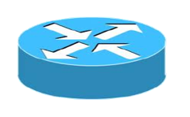
Traffic engineering: difficult
5
v
3
w
2
v
w
5
u
2
1
z
3
z
1
2
x
y
x
1
y
Q: what if w wants to route blue and red traffic differently?
A: can’t do it (with destination based forwarding, and LS, DV routing)
Notes:
Note: implicit assumption here: destination based forwarding
Problem:

Slide 6
Network-layer functions
Recall: two network-layer functions:
forwarding: move packets from router’s input to appropriate router output
data plane
routing: determine route taken by packets from source to destination
control plane
Two approaches to structuring network control plane:
per-router control (traditional)
logically centralized control (software defined networking)

Slide 7
Traditional Computer Networks
Data plane:
Packet streaming
  Forward, filter, buffer, mark,
  rate-limit, and measure packets
Notes:
Maybe this is a better picture… though need some details of what happens in each plane… like in next slides… or, have both?

Slide 8
Traditional Computer Networks
Per-router control plane:
Distributed algorithms
  Track topology changes, compute routes, install forwarding rules
Notes:
Maybe this is a better picture… though need some details of what happens in each plane… like in next slides… or, have both?
Individual routing algorithm components in each and every router interact with each other in control plane to compute forwarding tables

Slide 9
Traditional Computer Networks
Management plane:
Human time scale
  Collect measurements and configure the equipment
Notes:
Maybe this is a better picture… though need some details of what happens in each plane… like in next slides… or, have both?

Slide 10
Software Defined Networking (SDN)
Logically-centralized control
Smart,
slow
API to the data plane
(e.g., OpenFlow)
Dumb,
fast
Switches
Notes:
A distinct (typically remote) controller interacts with local control agents (CAs) in routers to compute forwarding tables
Extract the control part of routers to form a central controller

Slide 11
Software defined networking (SDN)
Why a logically centralized control plane?
easier network management: avoid router misconfigurations, greater flexibility of traffic flows
table-based forwarding allows “programming” routers
  centralized “programming” easier: compute tables centrally and distribute
  distributed “programming: more difficult: compute tables as result of distributed algorithm (protocol) implemented in each and every router
open (non-proprietary) implementation of control plane

Slide 12
SDN perspective: data plane switches
Data plane switches
fast, simple, commodity switches implementing generalized data-plane forwarding in hardware
switch flow table computed, installed by controller
API for table-based switch control (e.g., OpenFlow)
  defines what is controllable and what is not
protocol for communicating with controller (e.g., OpenFlow)
network-control applications
…
routing
access
control
load
balance
control
plane
northbound API
SDN Controller
(network operating system)
southbound API
data
plane
SDN-controlled switches

Slide 13
SDN perspective: SDN controller
SDN controller (network OS):
maintain network state information
interacts with network control applications “above” via northbound API
interacts with network switches “below” via southbound API
implemented as distributed system for performance, scalability, fault-tolerance, robustness
network-control applications
…
routing
access
control
load
balance
control
plane
northbound API
SDN Controller
(network operating system)
southbound API
data
plane
SDN-controlled switches

Slide 14
SDN perspective: control applications
network-control apps:
“brains” of control: implement control functions using lower-level services, API provided by SND controller
unbundled: can be provided by 3rd party: distinct from routing vendor, or SDN controller
network-control applications
…
routing
access
control
load
balance
control
plane
northbound API
SDN Controller
(network operating system)
southbound API
data
plane
SDN-controlled switches

Slide 15

OpenFlow (OF) defines the communication protocol that enables the SDN Controller to directly interact with the forwarding plane of network devices.

Slide 16
OpenFlow data plane abstraction
flow: defined by header fields
generalized forwarding: simple packet-handling rules
  Pattern: match values in packet header fields
  Actions: drop, forward, modify, matched packet or send matched packet to controller
  Priority: disambiguate overlapping patterns
  Counters: #bytes and #packets
* : wildcard
src=1.2.*.*, dest=3.4.5.* → drop
src = *.*.*.*, dest=3.4.*.* → forward(2)
3. src=10.1.2.3, dest=*.*.*.* → send to controller

Slide 17
OpenFlow data plane abstraction
match+action: unifies different kinds of devices
Router
  match: longest destination IP prefix
  action: forward out a link
Switch
  match: destination MAC address
  action: forward or flood
Firewall
  match: IP addresses and TCP/UDP port numbers
  action: permit or deny
NAT
  match: IP address and port
  action: rewrite address and port

Slide 18
Examples
Destination-based forwarding:
Switch
Port
MAC
src
MAC
dst
Eth
type
VLAN
ID
IP
Src
IP
Dst
IP
Prot
TCP
sport
TCP
dport
Action
*
*
*
*
*
*
51.6.0.8
*
*
*
port6
IP datagrams destined to IP address 51.6.0.8 should be forwarded to router output port 6
Firewall:
Switch
Port
MAC
src
MAC
dst
Eth
type
VLAN
ID
IP
Src
IP
Dst
IP
Prot
TCP
sport
TCP
dport
Forward
*
*
*
*
*
*
*
*
*
22
drop
do not forward (block) all datagrams destined to TCP port 22
Switch
Port
MAC
src
MAC
dst
Eth
type
VLAN
ID
IP
Src
IP
Dst
IP
Prot
TCP
sport
TCP
dport
Forward
*
*
*
*
*
128.119.1.1
*
*
*
*
drop
do not forward (block) all datagrams sent by host 128.119.1.1

Slide 19
Edge computing (2) Taking the Edge off with Espresso
Chen Qian
Department of Computer Science and Engineering
qian@ucsc.edu
https://users.soe.ucsc.edu/~qian/

Slide 20
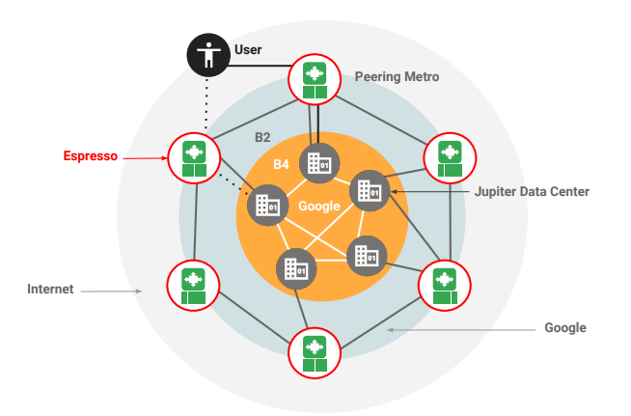
Background
edge metros or points of presence (PoPs)—connect Google to end users through external ISP peers

Slide 21
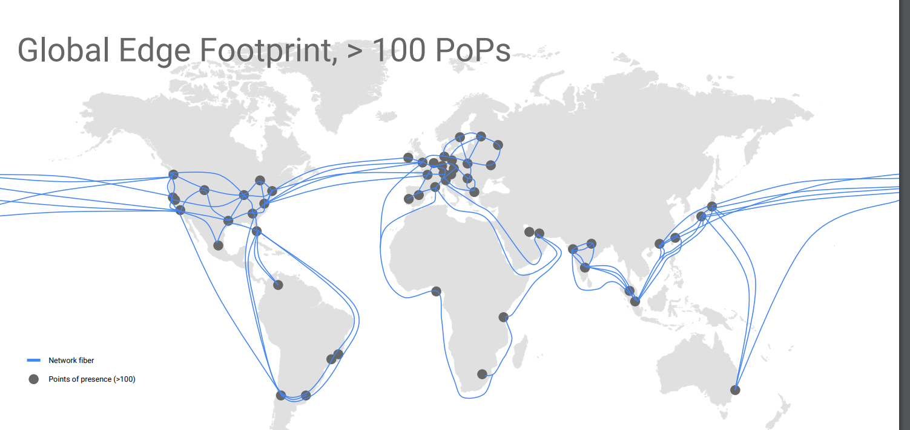

Slide 22
In tradition
Peering Routers (PR) connect Google’s network with other autonomous systems (AS) in the edge. These PRs support eBGP peerings, Internet-scale FIBs and IP access-control-lists to filter unwanted traffic.

Slide 23
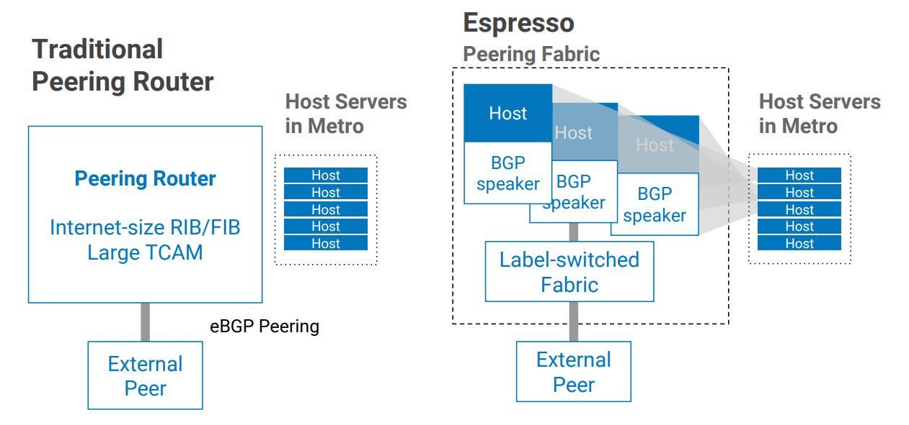

Slide 24
Data plane
A combination of a commodity MPLS switch (PF), and BGP speaker processes that support the traditional peering "router" capabilities.
PF has a small TCAM and limited on-box BGP capability.
It is capable of line rate decapsulation and forwarding of IP GRE and MPLS packets.
Internet-scale FIBs are in the servers.

Slide 25
Control plane
A global traffic engineering (TE) system enables application-aware routing at Internet scale.
Global TE controller (GC) and location controllers (LC), programs the packet processors with flow entries
Allows dynamic selection of egress port on per-application basis.

Slide 26
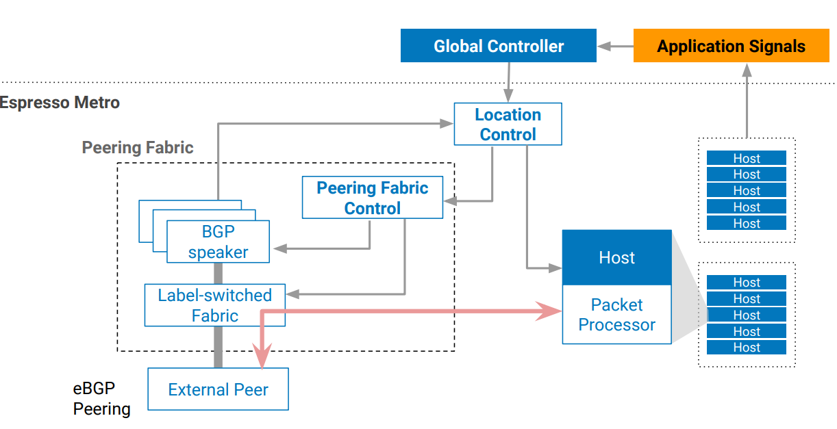

Slide 27
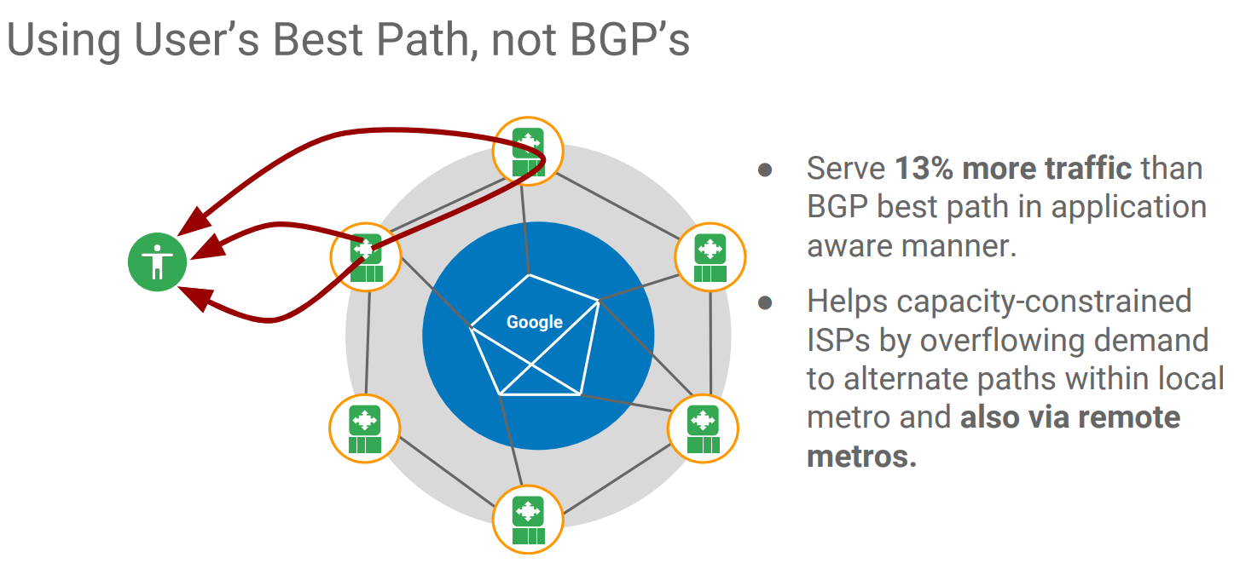

Slide 28
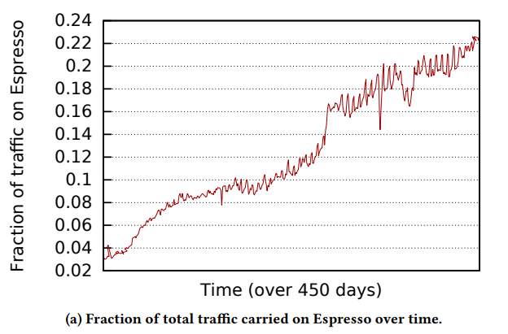

Slide 29
  Global Load Balancing
Purpose: Map clients to the server clusters of the CDN.
Clusters assignments are made at the granularity of map units.
  <IP address prefix, traffic class> e.g. <1.2.3.4/24, video>
Question: How to assign each map unit $M_{i},1≤i≤M$ to a server cluster $C_{j},1≤j≤N$

Slide 30
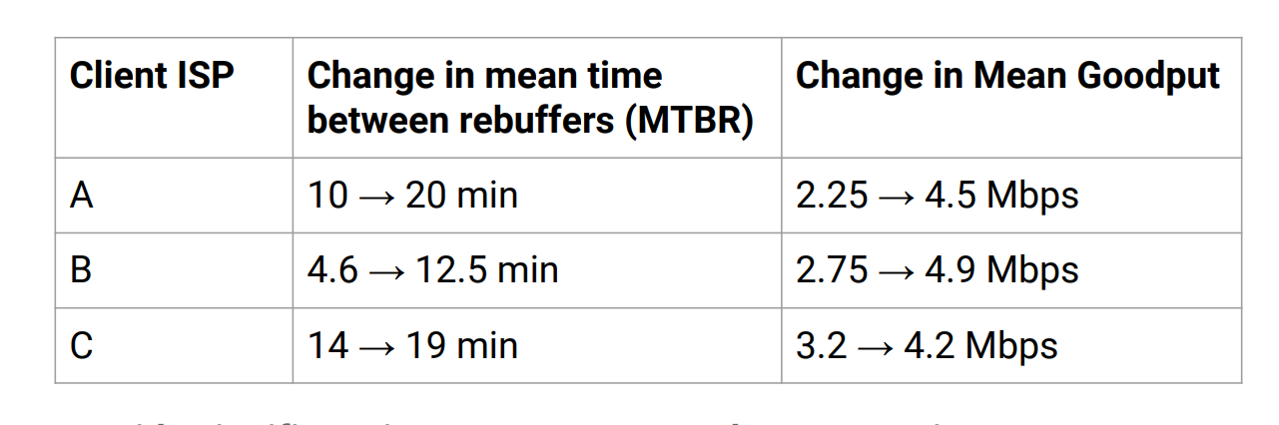
improvements to user experience observed by video player

Slide 31
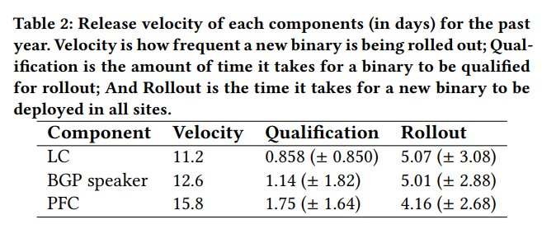
> 50× more frequently than with traditional peering routers.

Slide 32
Conclusion
Two principal criticisms of SDN
  it is best suited to walled gardens that do not require interoperability at Internet scale
  SDN mainly targets cost reductions.
This work shows that
  Espresso supports six times the feature velocity
  75% cost-reduction
  many novel features and exponential capacity growth relative to traditional architectures.

Slide 33
Thank You
Chen Qian
cqian12@ucsc.edu
https://users.soe.ucsc.edu/~qian/

