Slide 1

Cuckoo Hashing
Chen Qian
Department of Computer Engineering
qian@ucsc.edu
https://users.soe.ucsc.edu/~qian/

Slide 2
Recall Hash Table
A hash table is a storage for arbitrary function, where keys are sparsely distributed
  Usually hash the keys to a set of slots and store key and values there
  To save memory of storing sparse keys
Ideal performance:
  O(1) lookup
  n space
  O(1) insertion and deletion
h(key) mod N
0
2
key
h
N-1

Slide 3
Static Hashing
Each record (entry) has a key k
# primary pages fixed, allocated sequentially, never de-allocated; overflow pages if needed.
h(k) mod N = bucket to which data entry with key k belongs. (N = # of buckets)
h(key) mod N
0
2
key
h
N-1
Primary bucket pages
Overflow pages
Notes:
3
Buckets contain data records.
Hashing works on search key field of record r. Must distribute values over range 0 ... N-1.
h(key) = a binary number with 32/64/128/256 bits.
h(k) mod N is a way to distribute values
Long overflow chains can develop and degrade performance.
Extendible and Linear Hashing: Dynamic techniques to fix this problem.

Slide 4
Static Hashing (Contd.)
Buckets contain data records.
Hashing works on search key field of record r. Must distribute values over range 0 ... N-1.
  h(key) = a binary number with 32/64/128/256 bits.
  h(k) mod N is a way to distribute values
Long overflow chains can develop and degrade performance.
  Extendible and Linear Hashing: Dynamic techniques to fix this problem.
Notes:
4

Slide 5
(Minimal) Perfect Hashing:
No Collision but Update is Expensive
Perfect hashing
  maps all items with no collisions
K-V(b)
h(x)
K-V(e)
{a, b, c, d, e, f}
K-V(c)
K-V(d)
K-V(f)
K-V(a)
Notes:
F和h统一名字

Slide 6

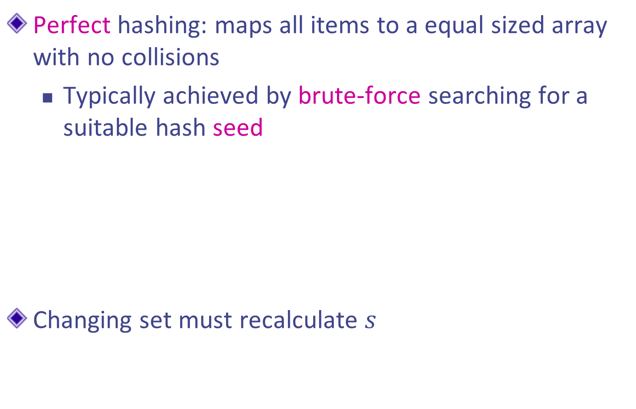
(Minimum) Perfect Hashing:
No Collision but Update is Expensive
Perfect hashing: maps all items to a equal sized array with no collisions
  Typically achieved by brute-force searching for a suitable hash seed
Changing set must recalculate $s$
K-V(b)
$$h_{s}(x)$$
K-V(e)
{a, b, c, d, e, f}
K-V(c)
s’ = ?
K-V(d)
{a, b, c, d, e, g}
K-V(f)
K-V(a)
bad performance of update

Slide 7
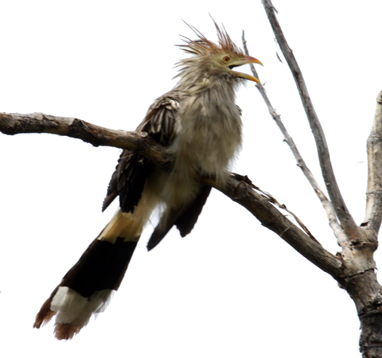
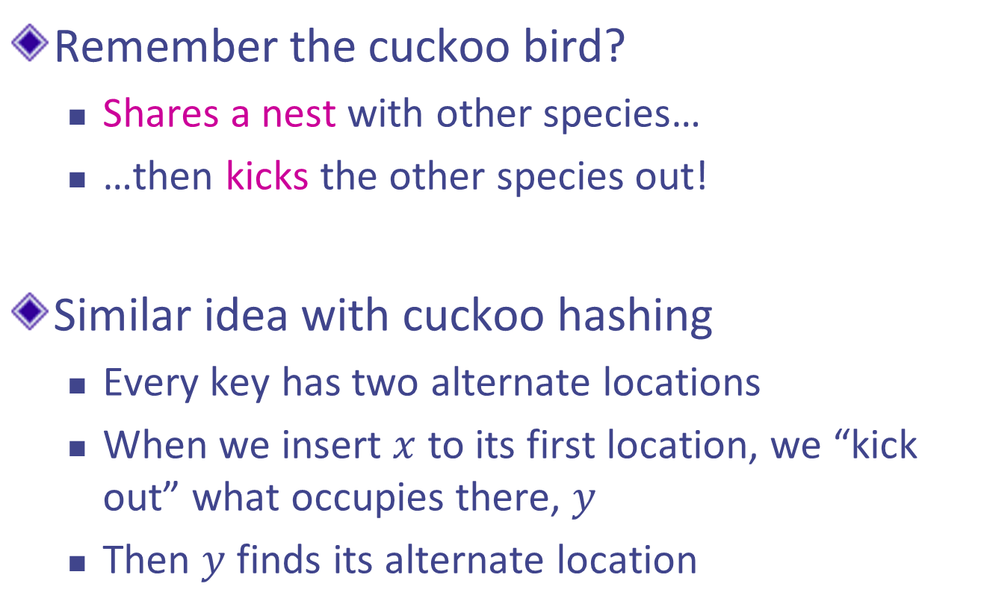
Cuckoo Hashing: the idea
Remember the cuckoo bird?
  Shares a nest with other species…
  …then kicks the other species out!
Similar idea with cuckoo hashing
  Every key has two alternate locations
  When we insert $x$ to its first location, we “kick out” what occupies there, $y$
  Then $y$ finds its alternate location

Slide 8
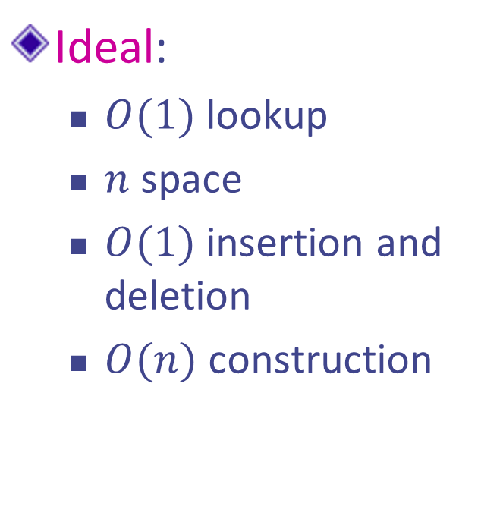
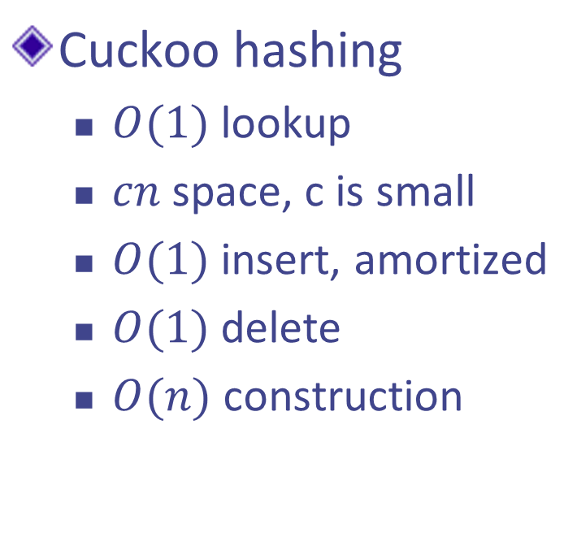
Why Cuckoo Hashing is cool?
Ideal:
  $O(1)$ lookup
  $n$ space
  $O(1)$ insertion and deletion
  $O(n)$ construction
Cuckoo hashing
  $O(1)$ lookup
  $cn$ space, c is small
  $O(1)$ insert, amortized
  $O(1)$ delete
  $O(n)$construction

Slide 9
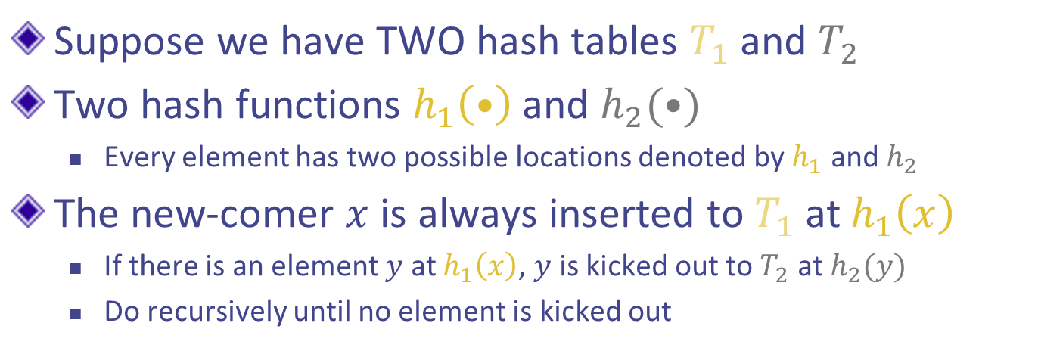


Cuckoo Hashing: Ver 1.0 - Two Tables
Suppose we have TWO hash tables $T_{1}$ and $T_{2}$
Two hash functions $h_{1}\left(•\right)$ and $h_{2}(•)$
  Every element has two possible locations denoted by $h_{1}$ and $h_{2}$
The new-comer $x$ is always inserted to $T_{1}$ at $h_{1}\left(x\right)$
  If there is an element $y$ at $h_{1}\left(x\right)$, $y$ is kicked out to $T_{2}$ at $h_{2}(y)$
  Do recursively until no element is kicked out
$$h_{2}\left(x\right)$$
$$h_{1}\left(x\right)$$
x

Slide 10



Cuckoo Hashing: Example
We want to insert $x$
No conflicts, inserted to $T_{1}$
$$h_{2}\left(x\right)$$
$$h_{1}\left(x\right)$$
x

Slide 11

Cuckoo Hashing : Example
Now we want to insert $y$
No conflicts, inserted to $T_{1}$
We use arrow to denote the alternate location
x
y

Slide 12
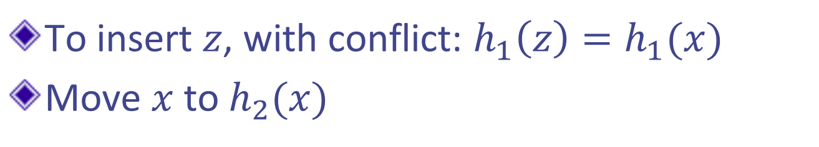
Cuckoo Hashing : Example
To insert $z$, with conflict: $h_{1}\left(z\right)=h_{1}(x)$
Move $x$ to $h_{2}(x)$
y
oh no!
x
z

Slide 13

Cuckoo Hashing : Example
Now we insert $z$ into $h_{1}(z)$
y
x
NOW we’re fine!
z

Slide 14
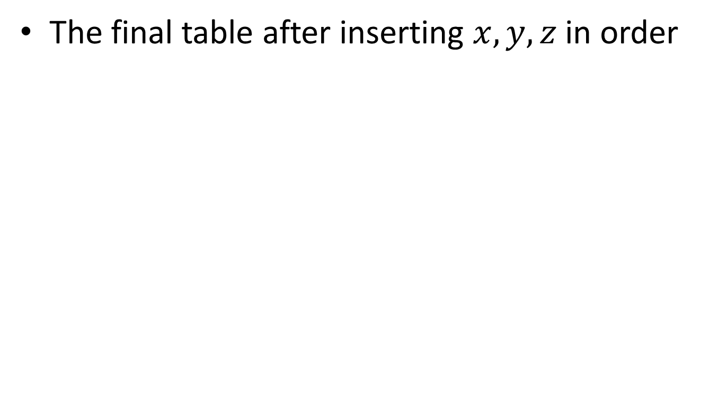
Cuckoo Hashing : Example
The final table after inserting $x,y,z$ in order
y
x
z

Slide 15
Why two tables?
Two tables, one for each hash function
But, why two?
Just two alternative locations in one table

Slide 16
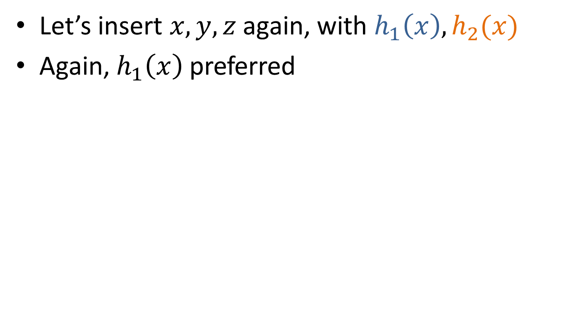


Ver 2.0 - One Table Example
Let’s insert $x,y,z$ again, with $h_{1}\left(x\right),h_{2}(x)$
Again, $h_{1}\left(x\right)$ preferred
$$h_{2}\left(x\right)$$
$$h_{1}\left(x\right)$$
x

Slide 17
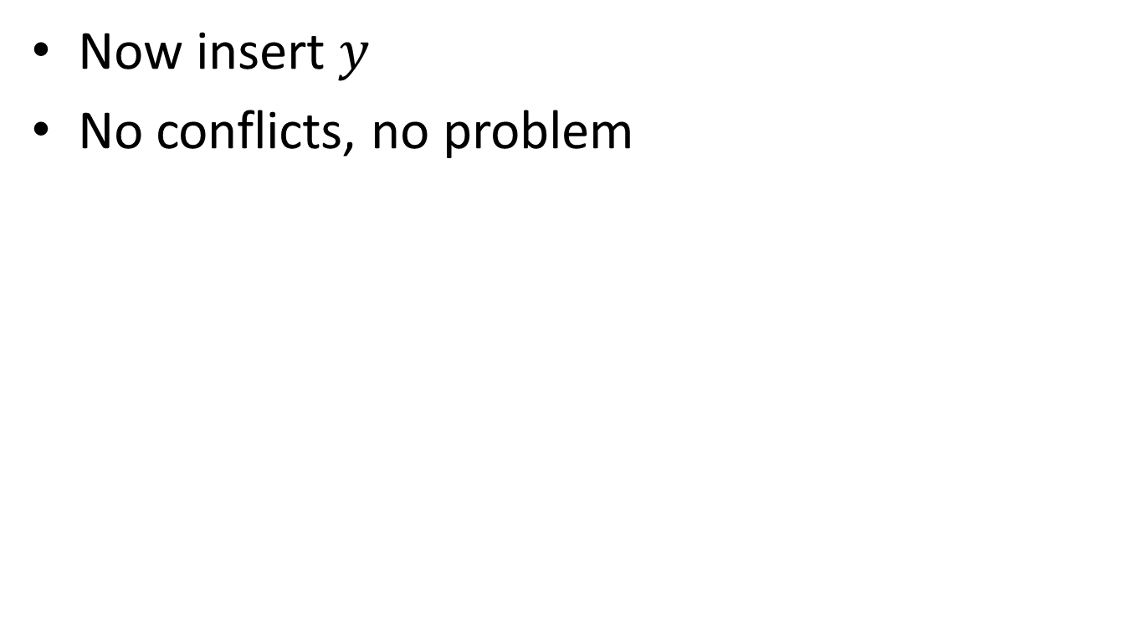


One Table Example
Now insert $y$
No conflicts, no problem
$$h_{2}\left(y\right)$$
x
$$h_{1}\left(y\right)$$
y

Slide 18



One Table Example
Now insert $z$
Conflict with $x$: $h_{1}\left(x\right)=h_{1}(z)$
Kick x out!
x
$$h_{1}\left(z\right)$$
y
z
$$h_{2}\left(z\right)$$

Slide 19

One Table Example
First, move $x$ to $h_{2}(x)$
Now we put $z$ to $h_{1}(z)$
x
y
z

Slide 20

One Table Example
First, move $x$ to $h_{2}(x)$
Now we put $z$ to $h_{1}(z)$
x
z
y

Slide 21
Infinite Insert
Suppose we insert something, and we end up in an infinite loop
  Or, “too many” displacements
  Some pre-defined maximum based on table size

Slide 22
Example: Loops
Remember our one-table example?
x
1
1
2
z
2
y
3
3
4
4
5
5

Slide 23
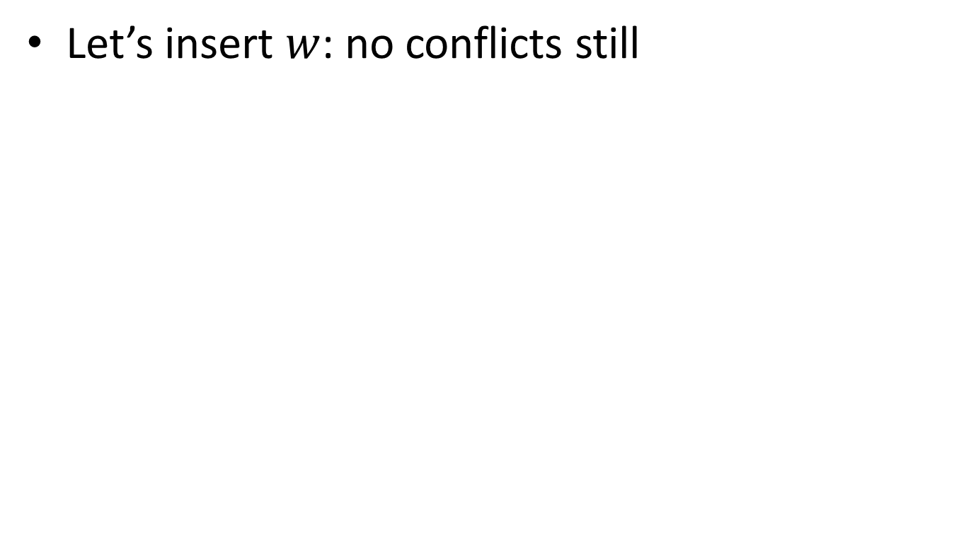
Example: Loops
Let’s insert $w$: no conflicts still
x
1
1
2
z
2
y
3
3
4
w
4
5
5

Slide 24
Example: Loops
There turns out to be a “kick-loop”
  No more insertion into this loop is possible
x
1
1
2
z
2
y
3
3
4
w
4
5
5

Slide 25

Example: Loops
Now let’s insert $a$
x
1
1
2
z
2
y
3
3
4
w
a
4
5
5

Slide 26

Example: Loops
Now $a$ is placed, and $x$ is kicked out
Try to insert $x$
a
1
1
2
z
2
y
3
3
4
w
x
4
5
5

Slide 27

Example: Loops
Now $x$ is placed, and $z$ is kicked out
Try to insert $z$
a
1
1
2
x
2
y
3
3
4
w
z
4
5
5

Slide 28

Example: Loops
Now $z$ is placed, and $w$ is kicked out
Try to insert $w$ …
a
1
1
2
x
2
y
3
3
4
z
w
4
5
5

Slide 29
Example: Loops
Notice what happens to the graph
We keep going and going and going….
1
2
3
4

Slide 30
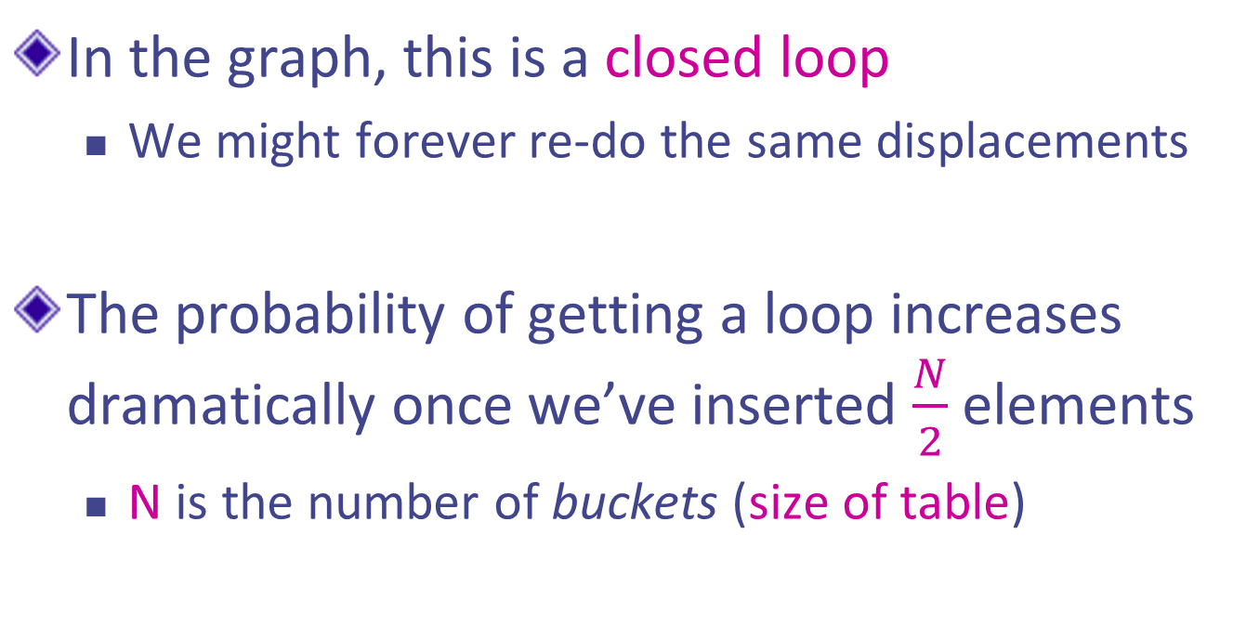
Analysis: Loops
In the graph, this is a closed loop
  We might forever re-do the same displacements
The probability of getting a loop increases dramatically once we’ve inserted $\frac{N}{2}$ elements
  N is the number of buckets (size of table)

Slide 31
Analysis: Loops
What can we do once we get a loop?
  Rebuild, same size
  Double table size then rebuild
We’ll need new hash functions for both choices
It depends on your design choice
  But eventually you need to double after many failed tries

Slide 32
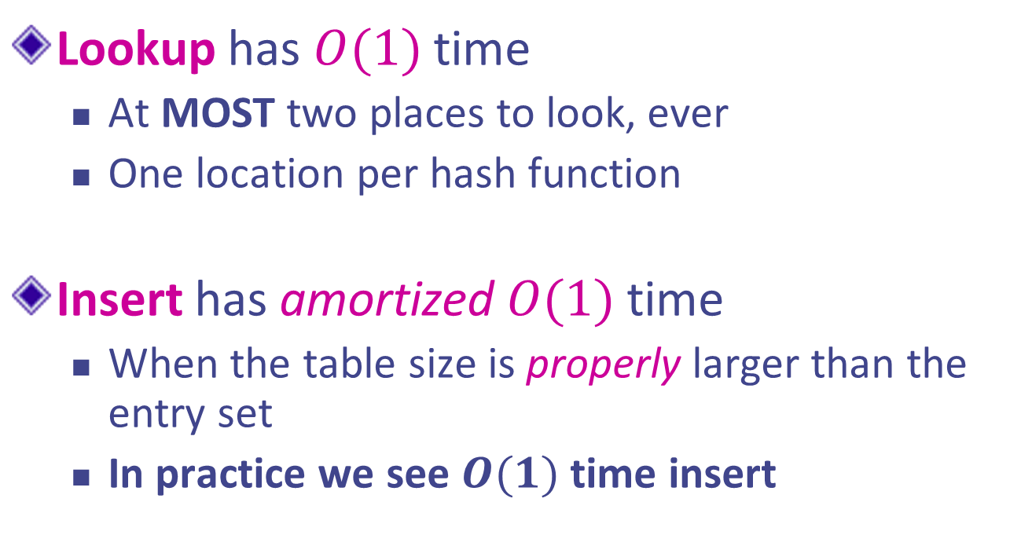
Analysis
Lookup has $O(1)$time
  At MOST two places to look, ever
  One location per hash function
Insert has amortized $O(1)$time
  When the table size is properly larger than the entry set
  In practice we see $O(1)$time insert

Slide 33
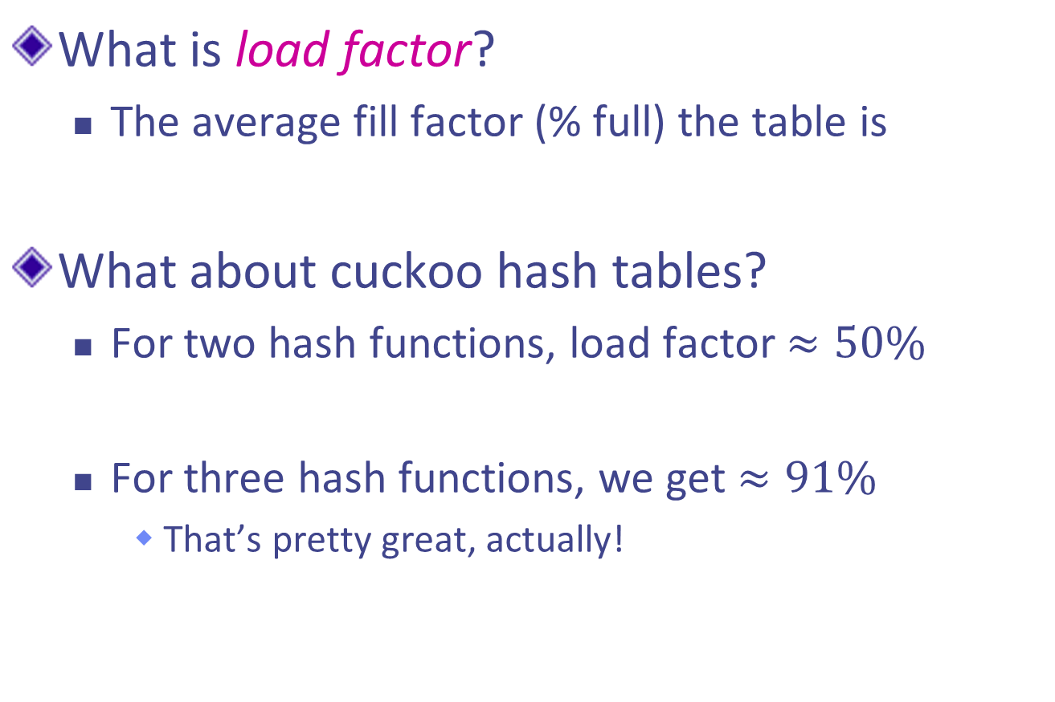
Analysis: Load Factor
What is load factor?
  The average fill factor (% full) the table is
What about cuckoo hash tables?
  For two hash functions, load factor $≈50\%$
  For three hash functions, we get $≈91\%$
    That’s pretty great, actually!

Slide 34
Ver 3.0 - More hash functions
What would this look like?
We would have 3 alternates for one key

Slide 35
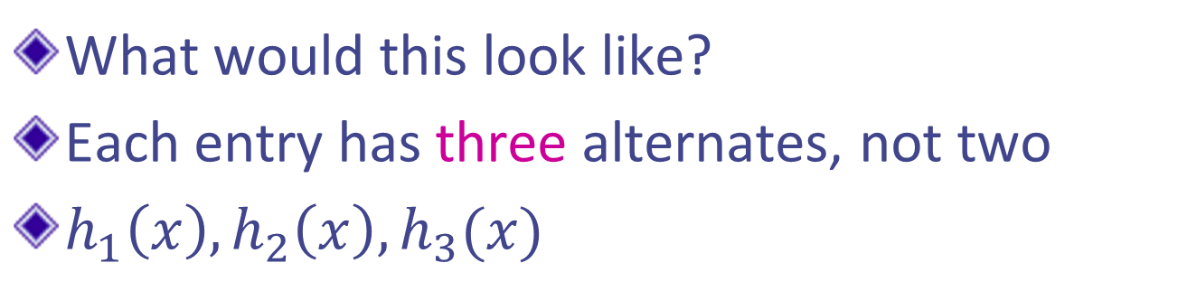
More hash functions
What would this look like?
Each entry has three alternates, not two
$h_{1}\left(x\right),h_{2}\left(x\right),h_{3}(x)$
x
z
y

Slide 36
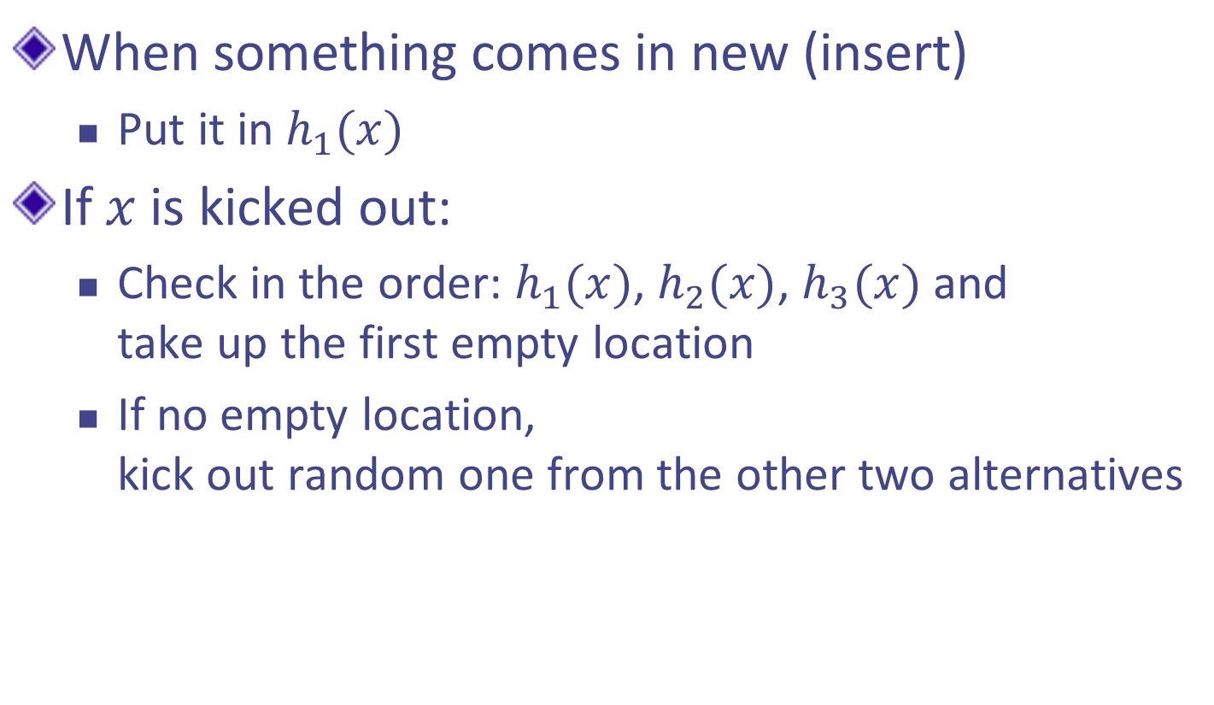
More hash functions
When something comes in new (insert)
  Put it in $h_{1}(x)$
If $x$is kicked out:
  Check in the order: $h_{1}(x)$, $h_{2}(x)$, $h_{3}(x)$ and
  take up the first empty location
  If no empty location,
  kick out random one from the other two alternatives

Slide 37

More hash functions
To lookup, we just look in the order: $h_{1}\left(x\right),h_{2},(x)$ and $h_{3}(x)$
  Still constant time, which is good
  Potentially 3 cache misses (+1), which is not so good

Slide 38
Ver 4.0 - More slots per location
Currently we’ve only put one item per bucket
What if we had two cells per bucket?
x, w
z, -
y, a
-, -

Slide 39
More slots per location
Currently we’ve only put one item per bucket
What if we had two cells per bucket?
What if we had four cells per bucket?
0:
hash₁(x)
1:
lookup(x)
2:
3:
hash₂(x)
4:
5:
6:
7:

Slide 40
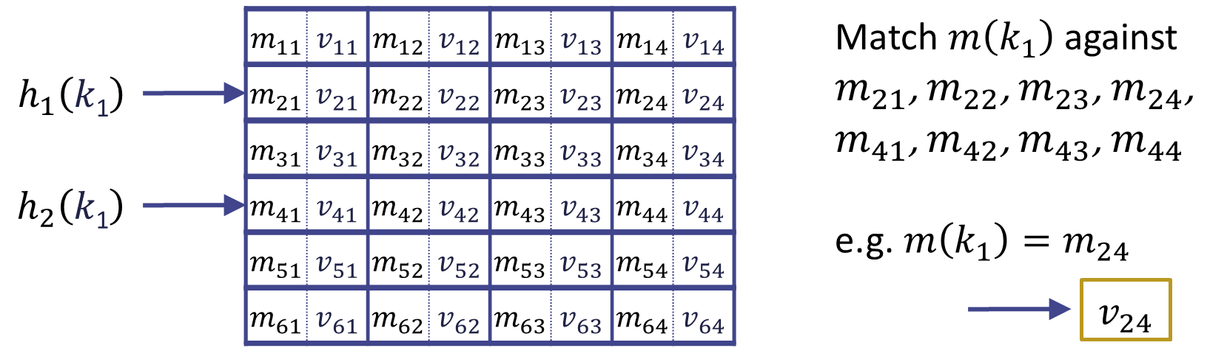
More slots per location

Slide 41
More slots per location
What about collision strategies?
  Round-robin (cells take turns swapping out)
  FIFO (oldest resident gets kicked out)
0:
hash₁(x)
1:
lookup(x)
2:
3:
hash₂(x)
4:
5:
6:
7:

Slide 42
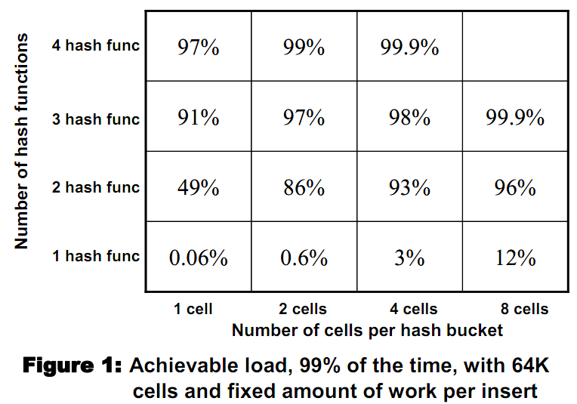
Results in two dimensions
2-hash-4-slot configuration is the most popular
  High load factor
  Low cache misses

Slide 43

Cuckoo Filter:
Practically Better Than Bloom
Bin Fan (CMU/Google)
David Andersen (CMU)
Michael Kaminsky (Intel Labs)
Michael Mitzenmacher (Harvard)
Notes:
Here comes an important variation of Cuckoo hashing. A new data structure called Cuckoo filter which works like a Bloom filter but with deletion support, high performance and less space overhead in many practical problems.

Slide 44
Succinct Data Structures for
Approximate Set-membership Tests
 | High Performance | Low Space Cost | Delete Support
Bloom Filter
Counting Bloom Filter
Quotient Filter
✔
✔
✗
✔
✗
✔
✗
✔
✔
Can we achieve all three in practice?
Notes:
A major limitation of using Bloom filters is that one could only insert new items but not able to delete these existing items. Thus for many years, people have been proposing different variances in order to improve Bloom filters so we could delete existing items. But they either lead to substantial increase of space cost like in counting Bloom filter, or become to expensive to operate like Quotient filter.
It looks like a tradeoff here according to this table. However, in this talk, we want to investigate that, is it possible that, for problems at practical scale, we really achieve three goals---enabling delete, with high performance and further reducing space cost---at the same time, rather than sacrificing one for another?

Slide 45
Outline
Background
Cuckoo filter algorithm
Performance evaluation
Summary
Notes:
Now let’s take a look at the algorithms.

Slide 46
Basic Idea: Store Fingerprints in Hash Table
Fingerprint(x): A hash value of x
  Lower false positive rate ε, longer fingerprint
0:
1:
2:
FP(a)
3:
4:
FP(c)
5:
6:
FP(b)
7:
Notes:
To present the design of cuckoo filter, I will first propose a simple approach to build a Bloom filter replacement with deletion support based on a hash table. Then I will explain the challenges for this hash table approach in achieving high performance and low space overhead at the same time, and finally I will present our solutions.
The basic idea of the hash table approach is very simple.
We compute a fingerprint for each item in the set of interest. The fingerprint is a summary of this item based on hash. Longer fingerprint helps to lower the chance of two different items colliding on the same fingerprint value.

Slide 47
Basic Idea: Store Fingerprints in Hash Table
Fingerprint(x): A hash value of x
  Lower false positive rate ε, longer fingerprint
Insert(x):
  add Fingerprint(x) to hash table
0:
1:
FP(x)
2:
FP(a)
3:
4:
FP(c)
5:
6:
FP(b)
7:
Notes:
we store each fingerprint of the set we are interested in to a hash table. As shown here. Fingerprint of X is stored in a bucket of the table

Slide 48
Basic Idea: Store Fingerprints in Hash Table
Fingerprint(x): A hash value of x
  Lower false positive rate ε, longer fingerprint
Insert(x):
  add Fingerprint(x) to hash table
Lookup(x):
  search Fingerprint(x) in hashtable
Lookup(x)
= found
0:
1:
FP(x)
2:
FP(a)
3:
4:
FP(c)
5:
6:
FP(b)
7:
Notes:
To lookup item x, we simply calculate this item’s fingerprint and check the hash table. If we find this fingerprint has been inserted in the hashtable return true. Note that, the same value of fingerprint can come from a different item, and in this case, we return false positive answers. Thus, to reduce the probability for this to happen we should use longer fingerprint.

Slide 49
Basic Idea: Store Fingerprints in Hash Table
Fingerprint(x): A hash value of x
  Lower false positive rate ε, longer fingerprint
Insert(x):
  add Fingerprint(x) to hash table
Lookup(x):
  search Fingerprint(x) in hashtable
Delete(x):
  remove Fingerprint(x) from hashtable
Delete(x)
0:
1:
FP(x)
2:
FP(a)
3:
4:
FP(c)
5:
6:
FP(b)
How to Construct Hashtable?
7:
Notes:
On deletion, which is not supported by Bloom filter, we again calculate the fingerprint of item to delete, and remove it from the hash table. Note that, this x must be inserted before, otherwise, we may get false deletion.
I believe the process looks pretty simple so far. But here comes the real and hard part of the question is, how do we build such a hash table and operate such a hash table, so that we to achieve high performance and also make the filter effectively even smaller than Bloom filter? Before we introduce our solutions, let’s go over a few strawman solutions first.

Slide 50
(Minimal) Perfect Hashing:
No Collision but Update is Expensive
Strawman
Perfect hashing: maps all items with no collisions
FP(b)
f(x)
FP(e)
{a, b, c, d, e, f}
FP(c)
FP(d)
FP(f)
FP(a)
Notes:
The first one is called perfect hashing. Assume we somehow find a hash function f(x) that maps each item in the set, in this example, 6 item a b, c, d, to f into a hash table with 6 entries, without making hash collision. If there is also no empty slot left, this is called minimal perfect hashing and it achieves the information theoretical lower bound in terms of table space.
However, one problem of this approach is that when we want to change the set, say we replace item f with item g

Slide 51
Recall (2,4)-Cuckoo hashing

Slide 52
Challenge: How to Perform Cuckoo?
Cuckoo hashing requires rehashing and displacing existing items
0:
1:
2:
FP(b)
Kick FP(c) to which bucket?
3:
4:
FP(c)
5:
Kick FP(a) to which bucket?
6:
FP(a)
7:
With only fingerprint,
how to calculate item’s alternate bucket?
Notes:
So far we understand how standard cuckoo hash works. Now let’s go back to our question and see the problem why this process is not compatible with fingerprints..
Standard cuckoo hash works by rehashing existing items on insert new items. But that in our case, only fingerprints are stored. Thus there is no way for us to rehash the original item and move it.
The takeway here, is with only the fingerprint stored, how do we perform cuckoo hashing, or essentially, how do we calculate the item’s alternate bucket.

Slide 53

We Apply Partial-Key Cuckoo
Solution
Standard Cuckoo Hashing: two independent hash functions for two buckets
Partial-key Cuckoo Hashing: use one bucket and fingerprint to derive the other ^{[Fan2013]}
  To displace existing fingerprint:
bucket1 = hash₁(x)
bucket2 = hash₂(x)
bucket1 = hash(x)
bucket2 = bucket1 hash(FP(x))
alternate(x) = current(x) hash(FP(x))
[Fan2013] MemC3: Compact and Concurrent MemCache
with Dumber Caching and Smarter Hashing
Notes:
So here is our solution.
First bucket …
Second bucket …
Note that, the xor operation helps ensure that: …

Slide 54
Partial Key Cuckoo Hashing
Solution
Perform cuckoo hashing on fingerprints
0:
1:
2:
FP(b)
Kick FP(c) to “4 hash(FP(c))”
3:
4:
FP(c)
5:
Kick FP(a) to “6 hash(FP(a))”
6:
FP(a)
7:
Can we still achieve high space utilization with partial-key cuckoo hashing?
Notes:
Go back to the previous example again. To kicking out Fingerprint of a, we first read its current bucket index which is 6, and use its stored fingerprint and calculate the alternate location, assuming it is 4.
Then the same happens to the fingerprint of c.
Now we solved the problem to perform cuckoo hash on fingerprints and can build a hash table with fingerprints only by modifying the standard way of cuckoo hash. So, we are still able to achieve the high space efficiency?

Slide 55
Fingerprints Must Be “Long” for Space Efficiency
Fingerprint must be Ω(logn/b) bits in theory
  n: hash table size, b: bucket size
  see more analysis in paper
When fingerprint > 5 bits, high table space utilization
Table Space Utilization
Table size: n=128 million entries
Notes:
The answer is, it depends. We analyzed partial-key cuckoo hashing and found that, if the fingerprints are too small, the table space could not be effectively utilized. In fact, the fingerprints must be Omega(logn/b) bits in order to ensure high space efficiency. Where n is table size, and b is bucket size.
Fortunately, for the scale of many practical problems, due to the constant factor and log n is divided by b, the threshhold to ensure high space occupancy is quite small. For example, we have a figure here that shows how much table space can be utilized in a table of 128 million entries, using different fingerprint size. X axis is the fingerprint size, Y axis is the utilization. As shown in this figure, the table is almost fully filled as long as the fingerprint is 5 bits or longer.
If you are interested, please refer to our paper for more details in the analysis and discussion.

Slide 56
Semi-Sorting: Further Save 1 bit/item
Based on observation:
  A monotonic sequence of integers is easier to compress^{[Bonomi2006]}
Semi-Sorting:
  Sort fingerprints sorted in each bucket
  Compress sorted fingerprints
+ For 4-way bucket, save one bit per item
-- Slower lookup / insert
Sort
fingerprints
21
97
88
04
04
21
88
97
fingerprints
in a bucket
Easier to compress
[Bonomi2006] Beyond Bloom filters: From approximate membership checks to ap- proximate state machines.
Notes:
By using cuckoo hashing to store fingerprints, we can already achieve high space efficiency. In the paper, we proposed and implemented an additional space optimization to further save 1 bit per item and I want to very briefly talk about it.
This optimization is built on an observation that a list of increasing integers is easier to compress than storing the same integers in a random order. In each of our bucket, we have 4 fingerprints and their order doesn’t affect the correctness of the algorithm. So we can sort these 4 fingerprints and compress them to gain 1 bit more. The downside of this approach is reading and updating the bucket requires compression and decompression, hence the performance is slower.

Slide 57
Space Efficiency
More Space
bits per item to achieve ε
Lower bound
More False Positive
ε: target false positive rate
Notes:
Compare the space efficiency of different schemes:
X axis is the target false positive rate.
Y axis is the required bits/item
pink curve here shows the lower bound required by information theory, this could be achieved by using minimal perfect hashing for a static set, but not able to mutate.

Slide 58
Space Efficiency
More Space
Bloom filter
bits per item to achieve ε
Lower bound
More False Positive
ε: target false positive rate
Notes:
Red line is the required bits per item achieved by a space-optimized Bloom filter. It is constantly larger than the lower bound.

Slide 59
Space Efficiency
More Space
Bloom filter
Cuckoo filter
bits per item to achieve ε
Lower bound
More False Positive
ε: target false positive rate
Notes:
Black and dotted line represents Cuckoo filter for the scale of practical problems. When we aim at lower false positive rate or want to filter to be more accurate, cuckoo filter is more compact compared to Bloom filter.

Slide 60
Space Efficiency
More Space
Bloom filter
Cuckoo filter
more compact than Bloom filter at 3%
bits per item to achieve ε
Lower bound
Cuckoo filter + semisorting
More False Positive
ε: target false positive rate
Notes:
The last and blue line here represents cuckoo filter with semi-sorting. As we mentioned before, this optimization further saves 1 bit per item from standard cuckoo filter, at the cost of performance which we will show later.
This variance of cuckoo filter is more compact than Bloom filter when e is smaller than 3%, which fits the need of maybe a large fraction of applications.

Slide 61
Outline
Background
Cuckoo filter algorithm
Performance evaluation
Summary

Slide 62
Evaluation
Compare cuckoo filter with
  Bloom filter (cannot delete)
  Blocked Bloom filter ^{[Putze2007]} (cannot delete)
  d-left counting Bloom filter ^{[Bonomi2006]}
  Cuckoo filter + semisorting
  More in the paper
C++ implementation, single threaded
[Putze2007] Cache-, hash- and space- efficient bloom filters.
[Bonomi2006] Beyond Bloom filters: From approximate membership checks to approximate state machines.

Slide 63
Lookup Performance (MOPS)
Cuckoo
Cuckoo +
semisort
d-left counting
Bloom
blocked
Bloom
(no deletion)
Bloom
(no deletion)
Notes:
We compare the lookup performance for different filters for lookup hit and lookup miss. Cuckoo filter delivers nearly 12 MOPS, no matter hit or miss.

Slide 64
Lookup Performance (MOPS)
Cuckoo
Cuckoo +
semisort
d-left counting
Bloom
blocked
Bloom
(no deletion)
Bloom
(no deletion)
Notes:
With semi-sorting which saves 1 bit per item, the performance is lower.

Slide 65
Lookup Performance (MOPS)
Cuckoo
Cuckoo +
semisort
d-left counting
Bloom
blocked
Bloom
(no deletion)
Bloom
(no deletion)
Notes:
D-left counting performs in between cuckoo and cuckoo with semisorting

Slide 66
Lookup Performance (MOPS)
Cuckoo
Cuckoo +
semisort
d-left counting
Bloom
blocked
Bloom
(no deletion)
Bloom
(no deletion)
Cuckoo filter is among the fastest regardless workloads.
Notes:
As base line blocked Bloom and standard Bloom cannot support delete. They perform about equal or less than standard cuckoo.

Slide 67
Insert Performance (MOPS)
Cuckoo
Blocked Bloom
d-left Bloom
Standard Bloom
Cuckoo +
semisorting
Cuckoo filter has decreasing insert rate, but overall is only slower than blocked Bloom filter.
Notes:
Here we show the insertion rate as shown in y axis, w.r.t the different level of table utilized as shown in x axis.
Bloom, blocked Bloom and d left Bloom all provide stable insertion rate, as they simply set a fixed number of bits or buckets on each insert. And among these three, blocked Bloom is the fastest with 8 million items inserted per second. For cuckoo, when the table is less filled, cuckoo provides the fastest insertion speed. When the table is more loaded, the insertion speed drops.
But overall speed, cuckoo is only slower to blocked Bloom

Slide 68
Summary
Cuckoo filter, a Bloom filter replacement:
  Deletion support
  High performance
  Less Space than Bloom filters in practice
  Easy to implement
Source code available in C++:
  https://github.com/efficient/cuckoofilter

